Slide 1

Web Scrapping and Analysis of Customer Reviews

Slide 2
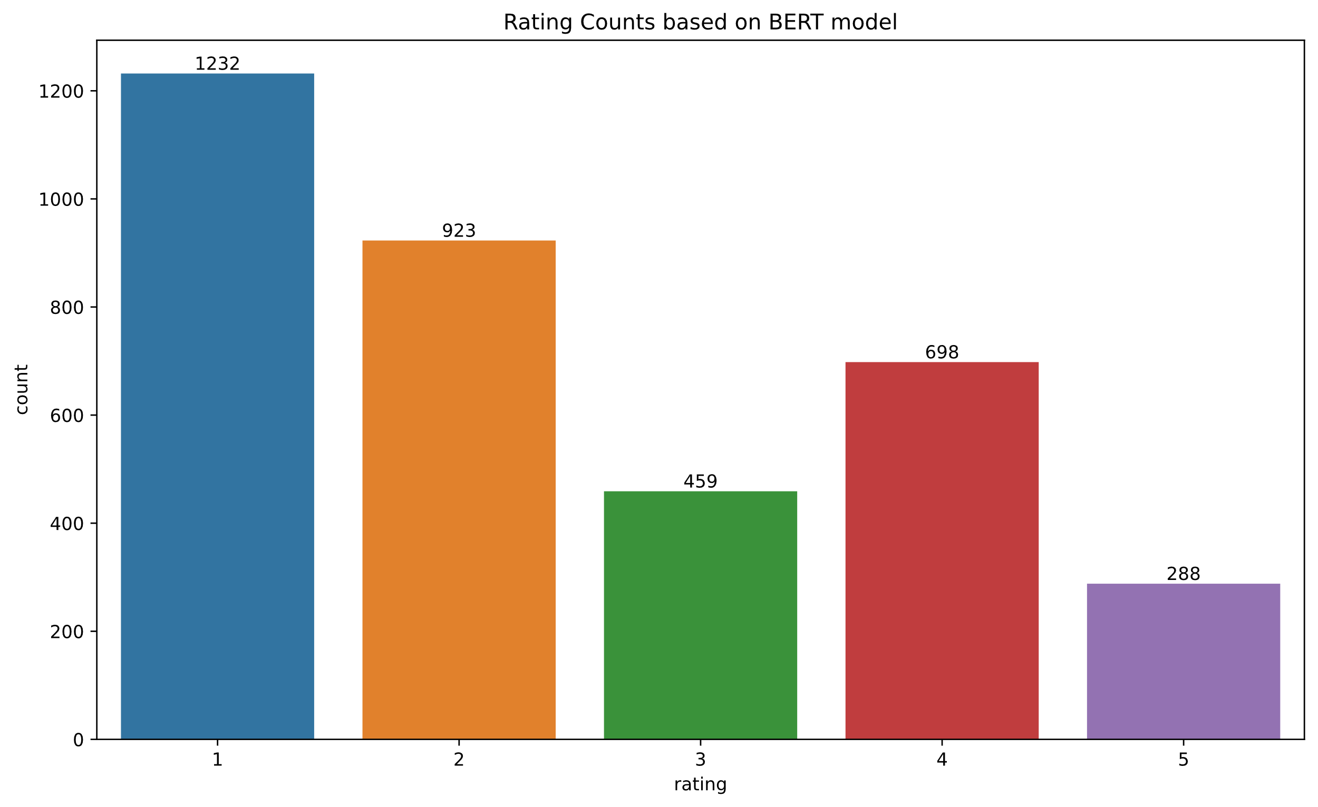
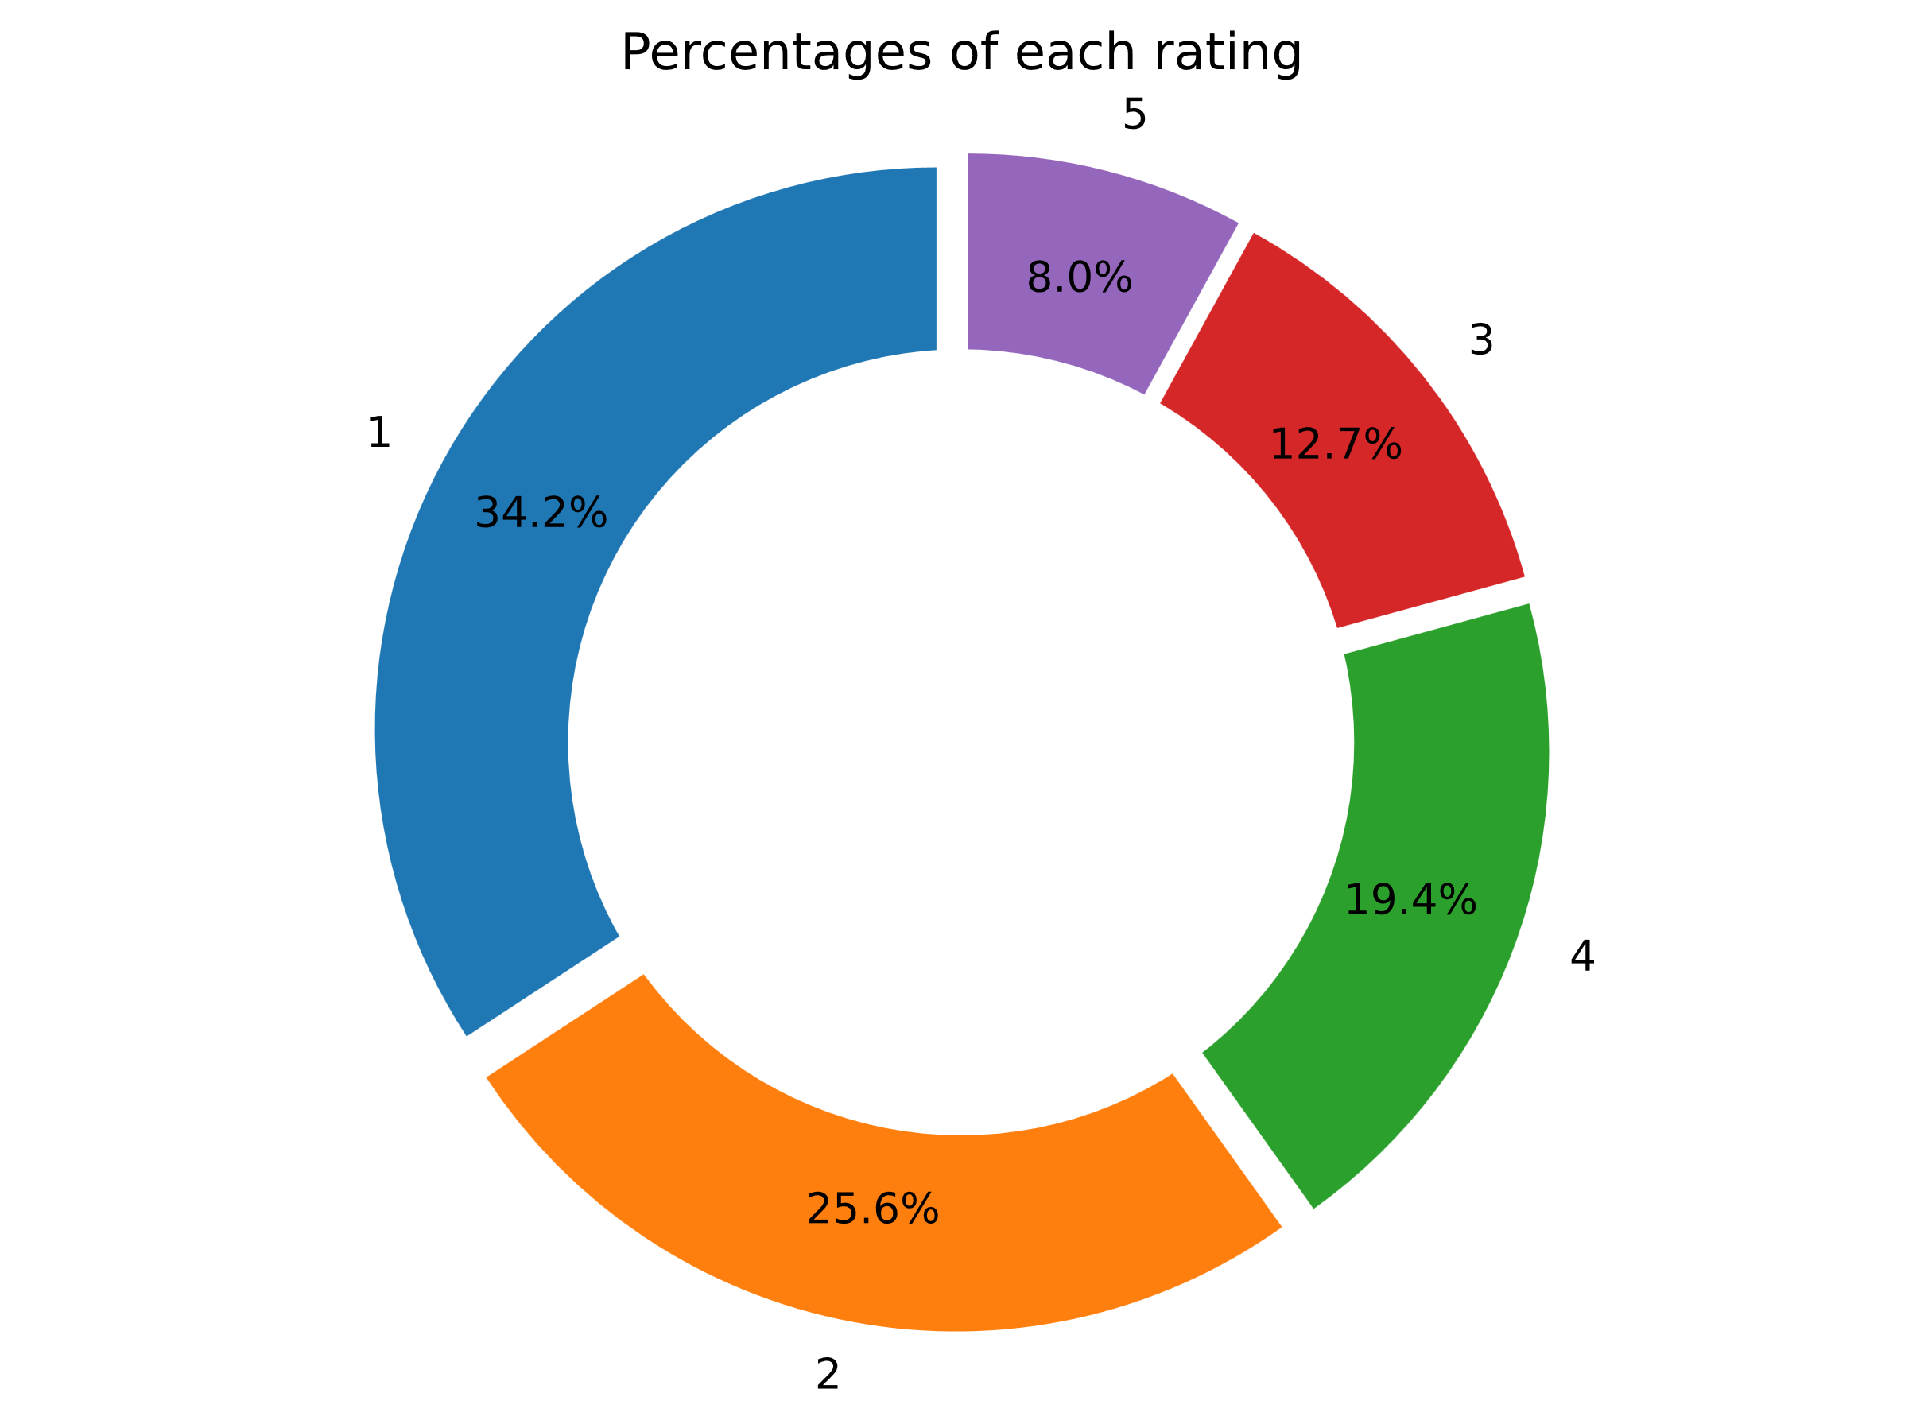
We performed a sentiment analysis on the reviews data using a pre-trained BERT model.
We took the most critical reviews and performed topic-modelling to analyze what customers were criticizing the most about. These are some of the facets customers possibly had issues with:
Poor customer Service at Heathrow Airport
Poor service at business class.
Uncomfortable seats and Economy class issues
Staff behavior
Ticket related issues especially regarding refunds
Issues regarding food offered during in-flight meals
Issues regarding the airlines and the trip itself
Luggage and baggage issues
Check-in and airport experience
In summary, the worst flight reviews with ratings of 1 out of 5 seem to be driven by a combination of factors such as poor customer service, uncomfortable seats, issues with business class services, dissatisfaction with meals, problems with ticketing and refunds, baggage-related concerns, and negative interactions with staff and the airport environment. These topics provide valuable insights into the specific pain points that led to the low ratings in these reviews.
We see that 34.2% of the reviews have been rated 1 out of 5. The average rating of all the reviews is 2.41

